Slide 1

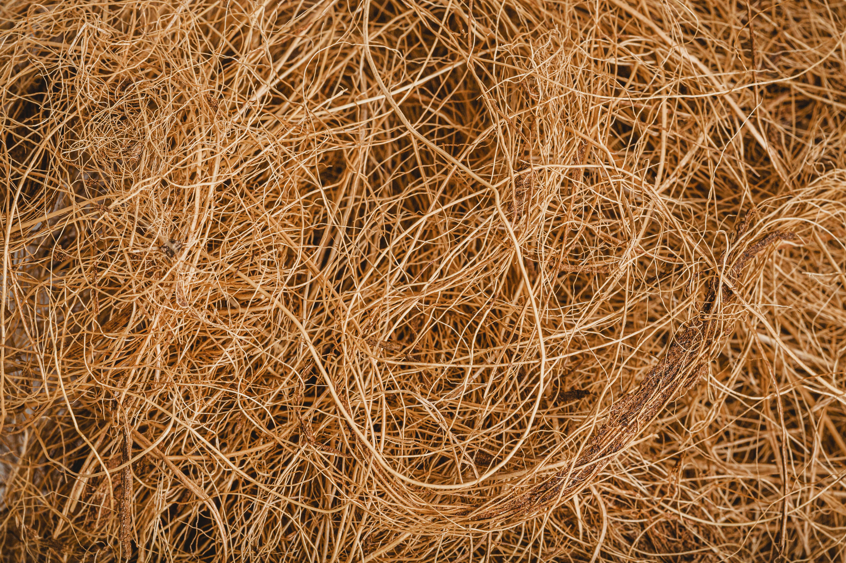

Presentation on major project
Course Coordinator: Dr. Hitesh Sharma
Under the Guidance of: Dr. Pawan Kumar Rakesh
Abhishek Dixit (BT20MEC007)
Satyam Singh Gurjar (BT20MEC008)

Slide 2
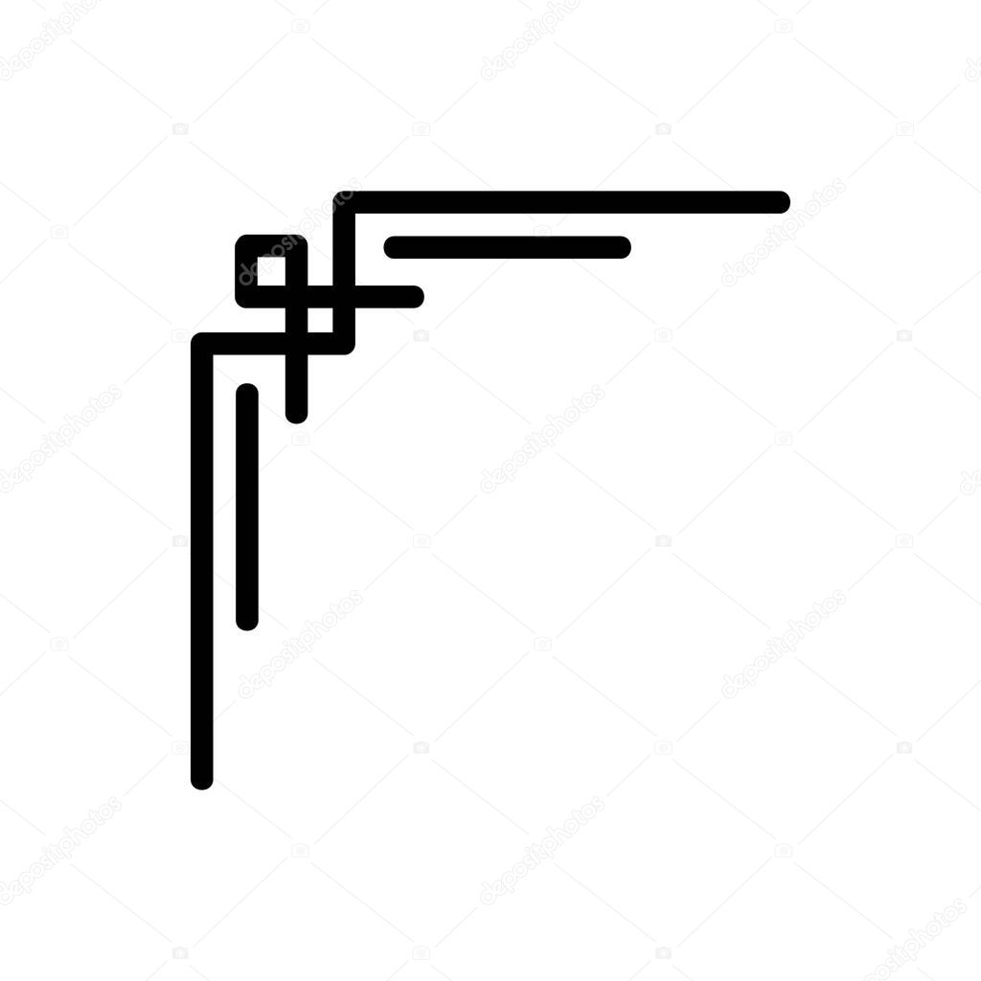
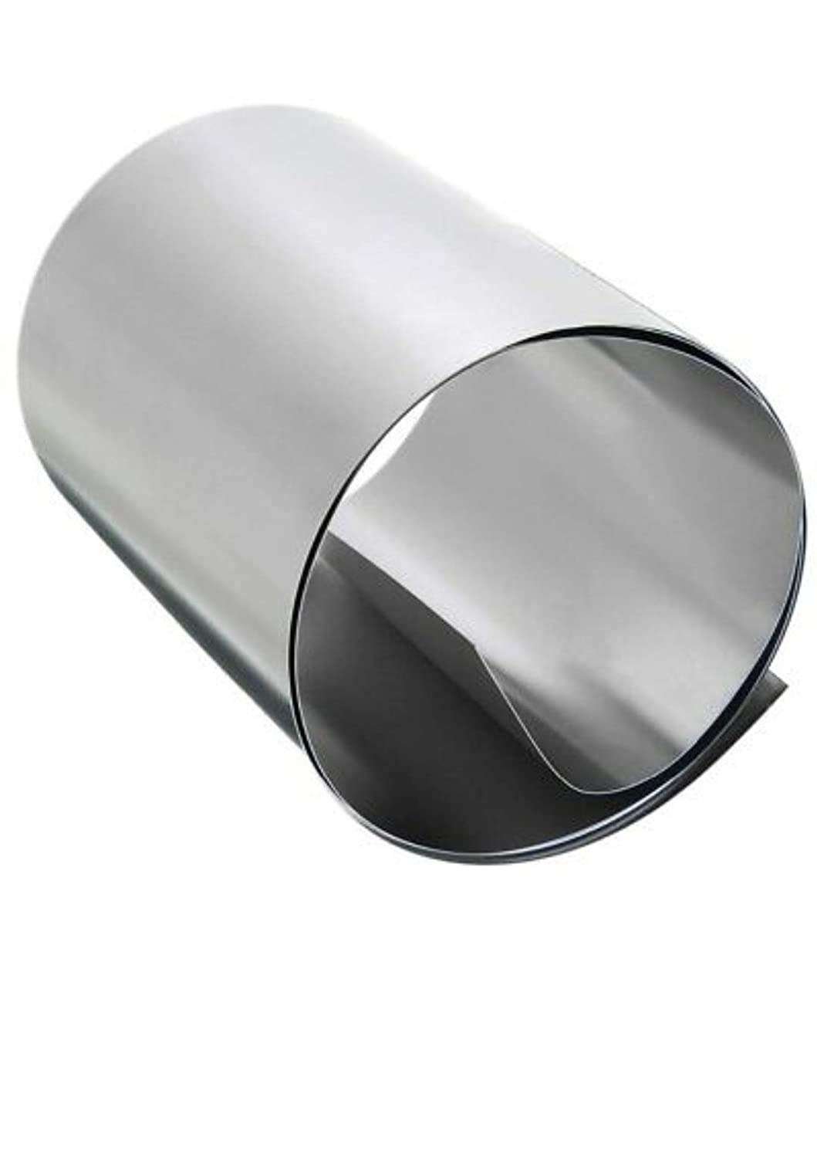

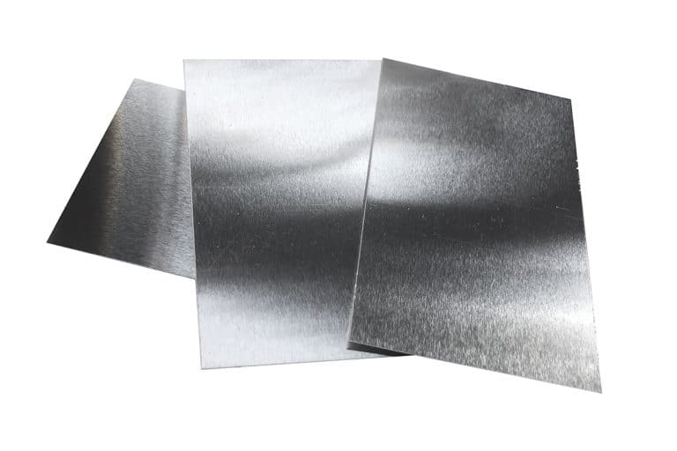
Joining Of Dissimilar Materials
(Aluminium, Coir Fiber Composite, And Galvanized Iron Sheet )
By Adhesive And Mechanical Fastening Techniques

Slide 3
Content
Introduction
Objective
Applications
Work done
Preparation Of Samples
Specification
Result

Slide 4
Introduction
The awareness of climate change is increasing worldwide, putting pressure on the vehicle industry to minimize emissions. Vehicle manufacturers are constantly looking for ways to decrease the emissions from their products. One way of doing this is by reducing the weight of the vehicles. Although, this has to be done at the same time as acceptable mechanical and comfort properties are maintained. Manufacturers today are trying to solve this by using lightweight materials such as high-strength steel to create vehicles with increased crash safety and decreased weight. Others are looking at fiber composites, aluminum, or magnesium, which also are materials with a high strength-to-weight ratio [1].
The joining of dissimilar materials is a critical step in many industrial processes and applications [Fig 1], and the choice of technique will depend on the application’s specific requirements.
Each technique has its own advantages and disadvantages, and the choice of technique will depend on the application's specific requirements. For example, welding provides a strong, permanent bond but may not be suitable for all materials, while adhesive bonding offers versatility but may not provide the same level of strength as welding.[6]

Slide 5
OBJECTIVE
To create samples of Aluminum alloy, Coir composite, and Galvanized Iron sheet.
To join samples through Mechanical Fastening, and Adhesive Bonding techniques.
Static Structural analysis of samples in Ansys software.

Slide 6
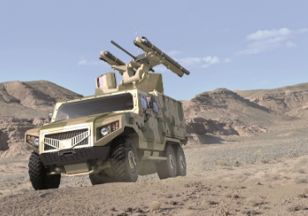

APPLICATIONS
Aerospace and Defense
Automotive
Construction
Medical
Electronics Industry
Marine Industry
Figure 1: Applications
Source: https://www.mariongeneral.com/hospitals-ohio-adapting-continued-advancement-medical-equipment/

Slide 7
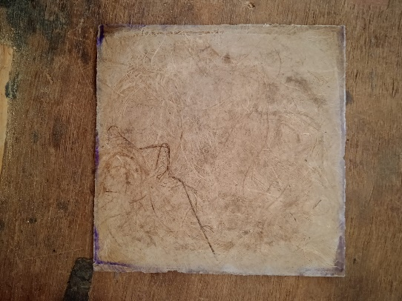
Coir composite
Physical and mechanical composition
The value of selected physical and mechanical coir fibers as analyzed through the research paper and Coir fibers can be said to have 1.1–1.5 g/cm3 density, 2–8 GPa Young’s modulus, and 105–593 MPa tensile strength, 10–180% water absorption and 15–51% elongation at break. The variation of these properties may depend on the source of the fiber, pre-treatment, and extraction methods.[4]
Figure 2: Coir Composite

Slide 8
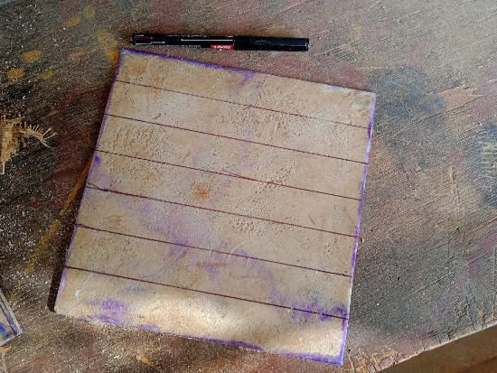
Prepare three samples of coir composites of dimension 200*200*3 mm^3. Then, cut the sample of dimension into 200*25*3 mm^3 with the grinder of blade 4 inches. Here, figure 3 shows the coir composite sample.
Figure 3: Samples of coir composite with dimensions of 200*200*3 mm^3

Slide 9
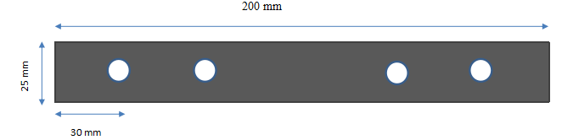
Aluminium Alloy
The most commonly used aluminum alloys for construction and manufacturing applications are 6061-T6 and 6063-T5. These alloys have good mechanical properties and are relatively easy to fabricate, making them ideal for a variety of applications. 6061-T6 is used for this project. Cut the Aluminum and Galvanized Iron sheets into dimensions of 200*25 mm2 with a snipping tool. The thickness of the Aluminum sheet is 0.3 mm. Then drill four holes at a distance of 30mm from the end by drilling machine diameter of 3.5mm.
Figure 4: Dimension of sample

Slide 10
Mechanical properties of Aluminum Alloy 6061-T6 [5]
Properties | Metric | Imperial
Tensile strength | 310 MPa | 45000 psi
Yield strength | 276 MPa | 40000 psi
Shear strength | 207 MPa | 30000 psi
Fatigue strength | 96.5 MPa | 14000 psi
Elastic modulus | 68.9 GPa | 10000 ksi
Poisson's ratio | 0.33 | 0.33
Elongation | 12-17% | 12-17%
Hardness, Brinell | 95 | 95

Slide 11
Galvanized Iron Sheet
GI sheets are typically made of cold-rolled carbon steel that has been coated with zinc to protect against corrosion. The most common type of GI sheet is hot-dip galvanized steel, which is produced by immersing the steel in a bath of molten zinc.
Mechanical properties of Galvanized Iron (Grade 33)[5]
Mechanical Properties | Metric | English
Modulus of Elasticity | 200 GPa | 29000 ksi
Bulk Modulus | 160 GPa | 23200 ksi
Poissons Ratio | 0.29 | 0.29
Shear Modulus | 80.0 GPa | 11600 ksi

Slide 12
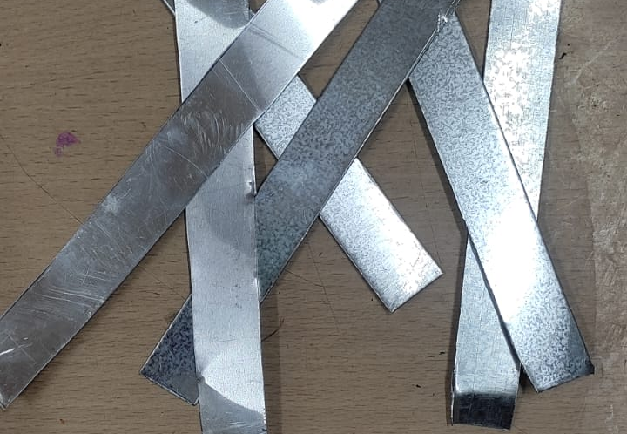
Cut the Galvanized Iron sheets into dimensions of 200*25 mm2 with a snipping tool. The thickness of the Galvanized sheet is 0.6 mm. Then, prepare 18 samples of Galvanized Iron and 36 Aluminum sheets because to maintain uniformity in the thickness of both sheets, so take we used two aluminum sheets, one coir composite sample, and one galvanized iron sheet. Figure 5 shows the samples of Aluminum sheets and galvanized sheets. So, the total thickness of the combined sample is 4.2 mm.
Figure 5: Galvanized Iron sheets and Al alloy sheets

Slide 13
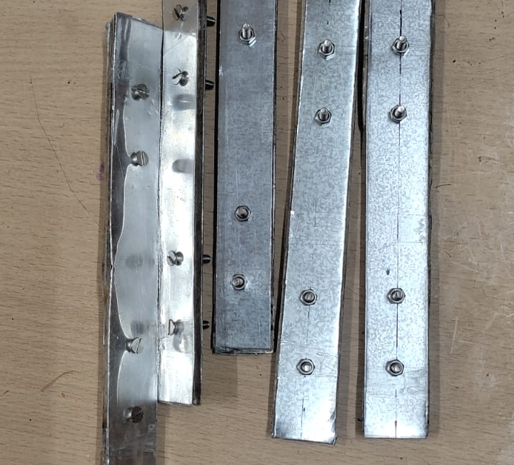
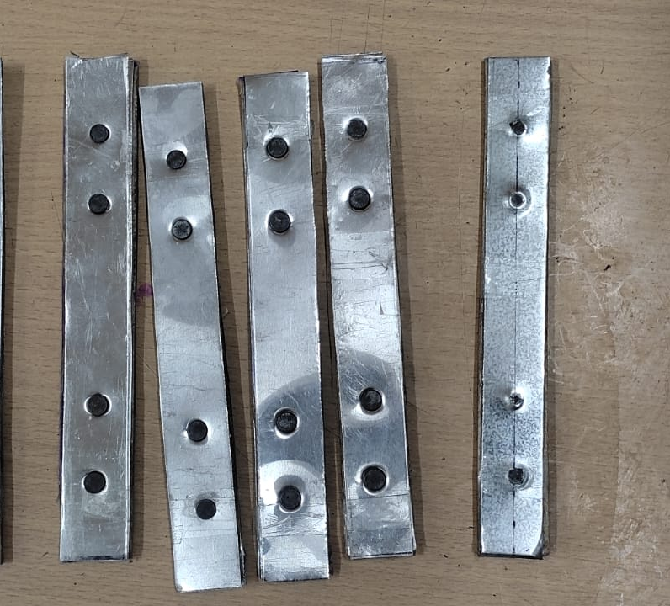
Joining techniques
Mechanical Fastening
Figure 6: Joining through the Nut-Bolt technique
Figure 7: Joining through the riveting technique

Slide 14
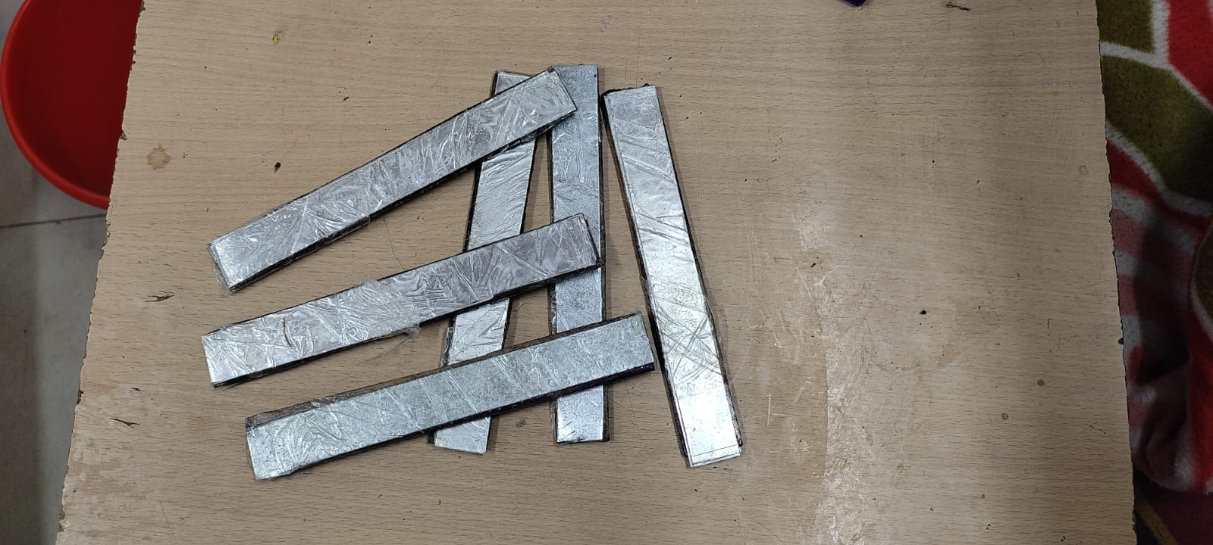
Adhesive joining
Epoxy is suitable for bonding both metal and composite materials. Epoxy is used with a hardener in a ratio of 1:10.
Figure 8: Joining through the adhesive technique

Slide 15
Materials Used
S.No. | Material | Specification
1. | Aluminium Alloy (T6 6061) | 250*25*0.3 mm^3
2. | Galvanized iron | ASTM A653 G90 250*25*0.6 mm^3
3. | Nut Bolt Rivet | Medium-carbon steel (0.3-0.5% C) Diameter of 3.5mm and length of 20mm. Medium-carbon steel (0.3-0.5% C) Diameter of 3.5mm and length of 7mm
4. | Hardener | HY591
5. | Coir | 1.2 to 1.5 g/cm3
6. | Epoxy | Araldite® LY 556

Slide 16
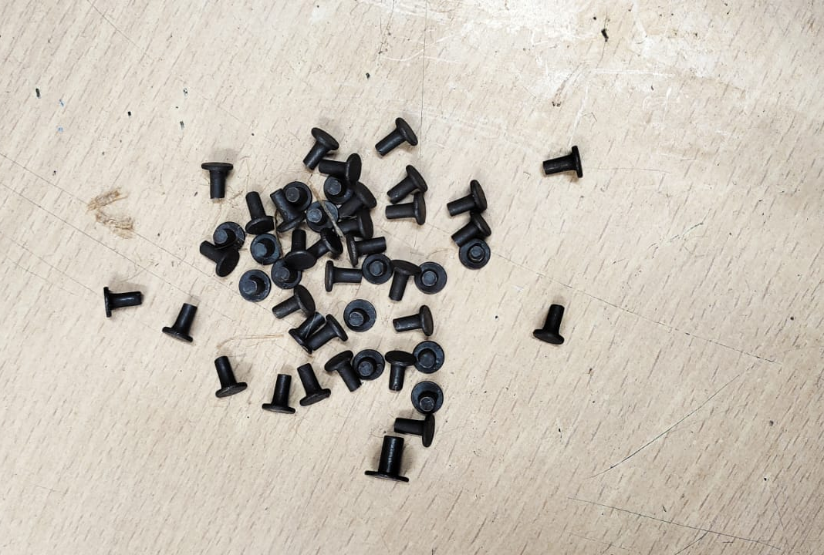
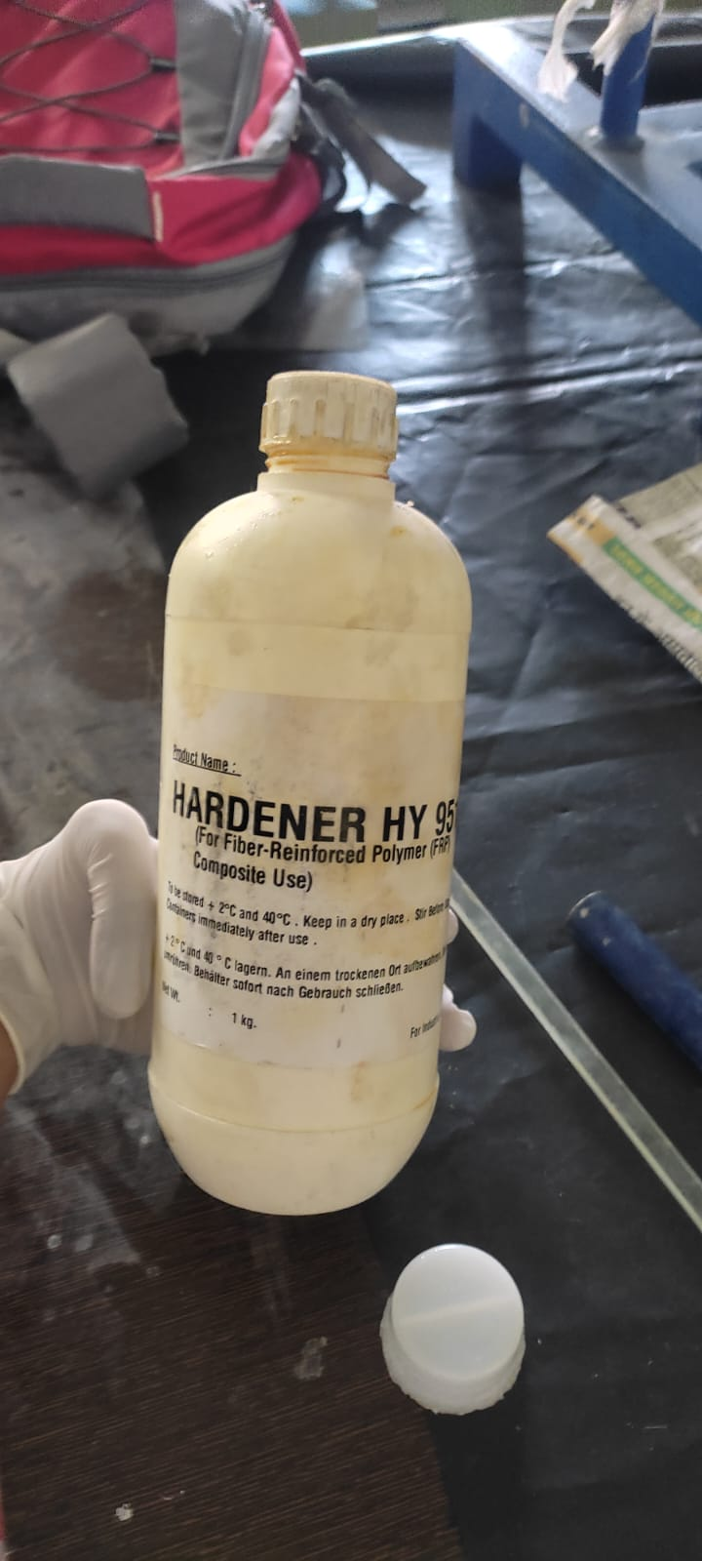
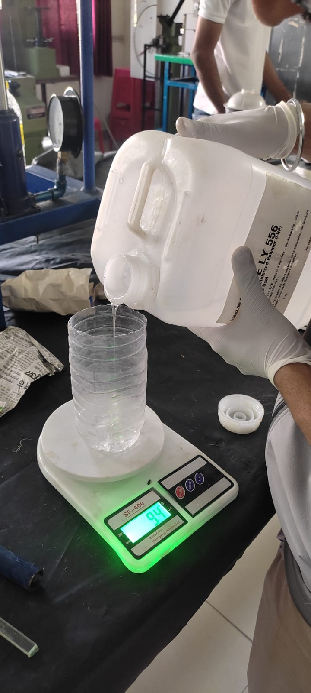
glimpse of samples preparation

Slide 17
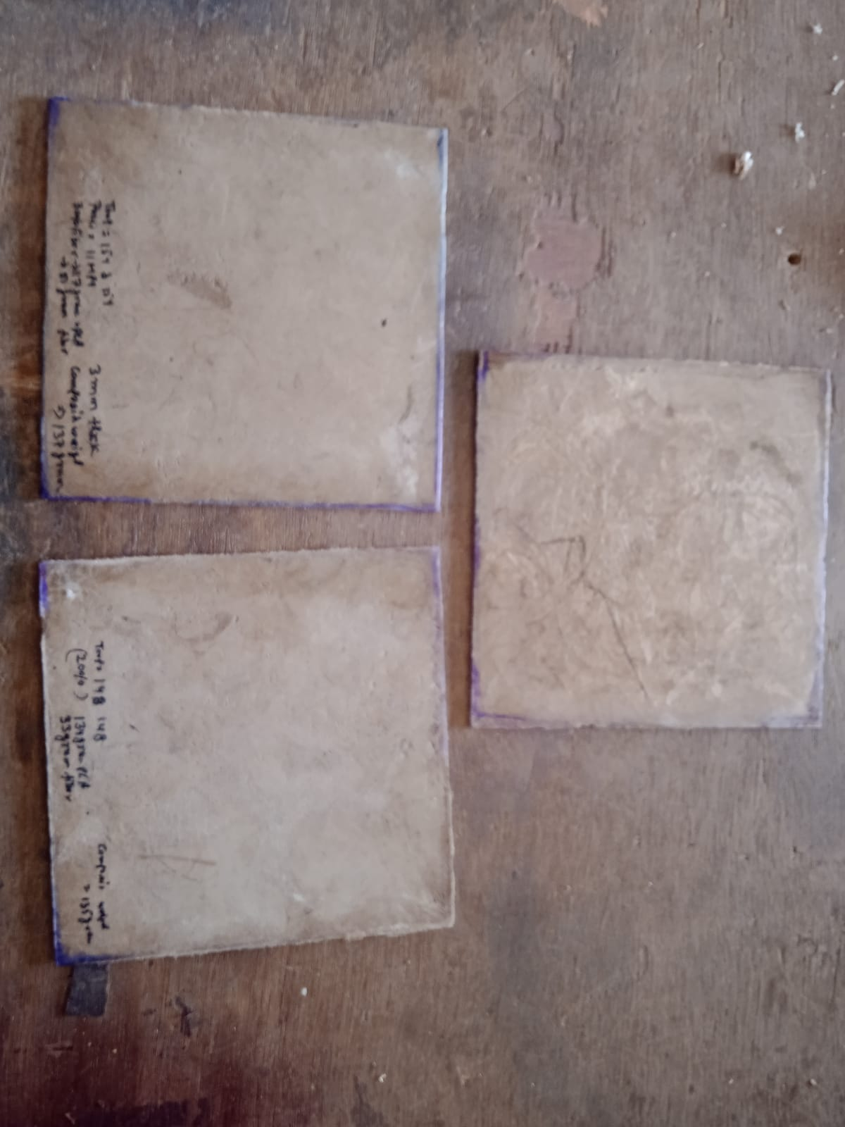
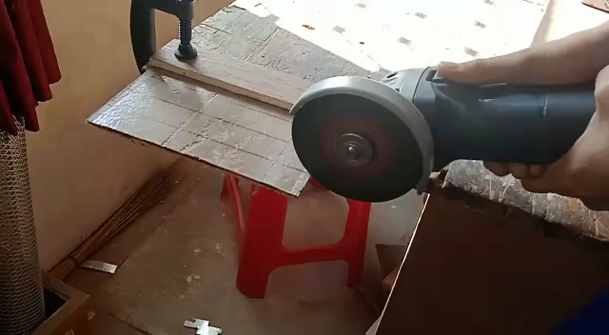
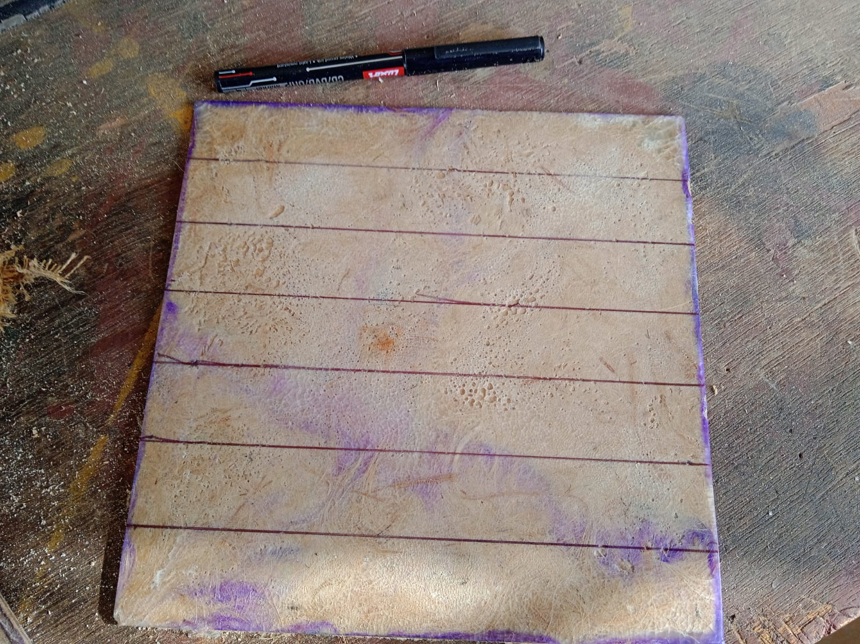
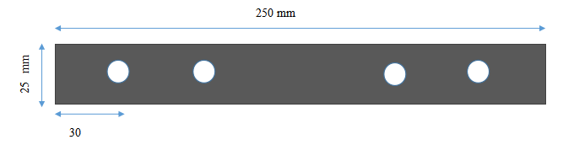

Slide 18
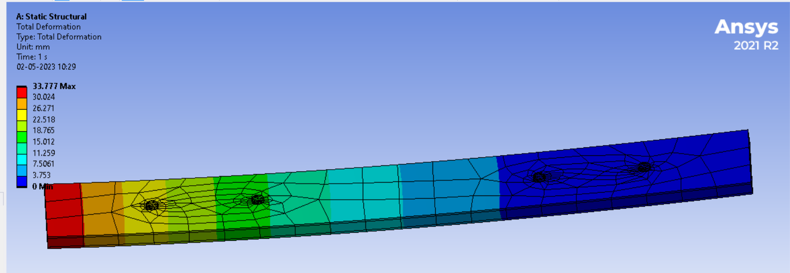
Results
Figure 9: Deformation in mechanical fastening joining by applying pressure of 100MPa in unidirectional

Slide 19
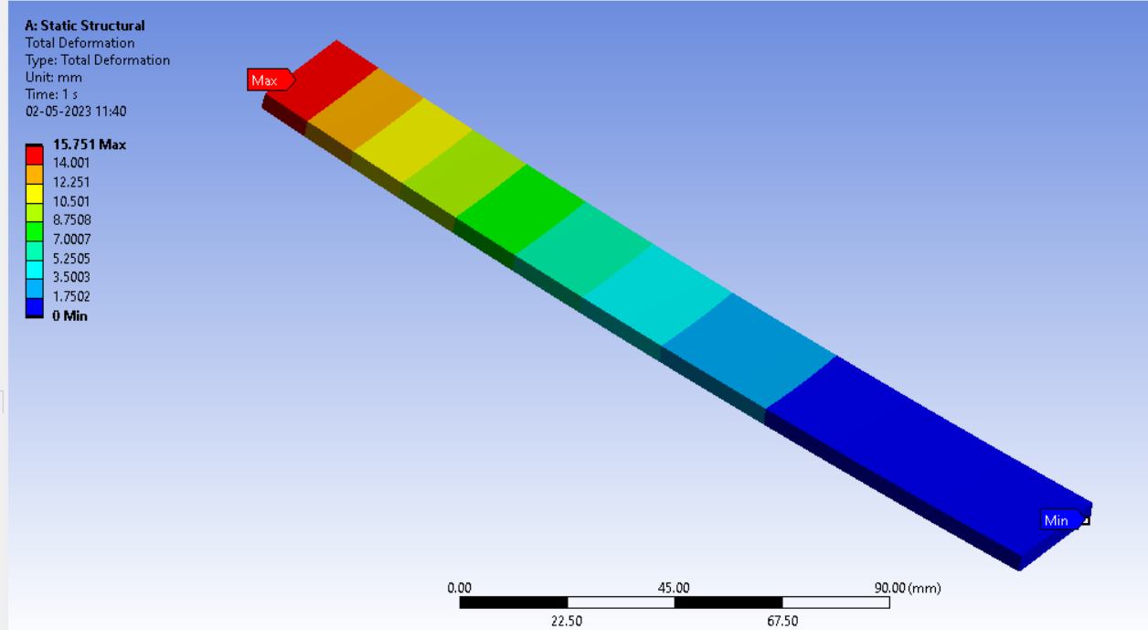
Figure 10: Deformation in Adhesive joining by applying pressure of 100MPa in unidirectional

Slide 20
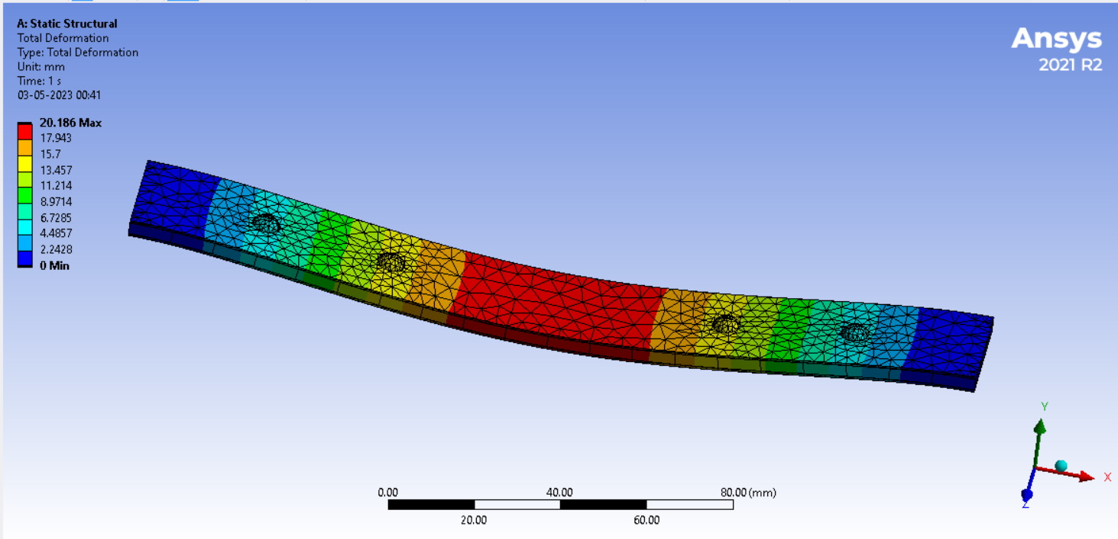
Figure 11: Deformation in samples when bending movement is analyzed by applying 10000 N force at the centre keeping both end constraints

Slide 21
Conclusion
As the analysis of adhesive and mechanical fastening techniques, the deformation is more in joining through mechanical fastening rather than adhesive joining because, in mechanical fastening, the maximum deformation is 33.77 mm while in adhesive joining it is 15.751 mm. So, adhesive joining is best for joining dissimilar materials. However, adhesive joining also has some limitations. Adhesives require clean and properly prepared surfaces for bonding, which can be time-consuming and require special equipment or techniques. Adhesives can also be affected by temperature, moisture, and chemicals, which can weaken the bond or cause failure over time. Additionally, adhesives may not provide the same level of strength and durability as other joining methods in certain applications. In conclusion, adhesive joining can be a viable option in many cases, but it is not always the best choice.

Slide 22
references
https://www.sciencedirect.com/science/article/pii/S2588840417300094
https://www.tandfonline.com/doi/full/10.1080/01694243.2020.1855909
S.K. Saw, G. Sarkhel, A. Choudhury Surface modification of coir fiber involving oxidation of lignins followed by reaction with furfuryl alcohol: characterization and stability Appl Surf Sci, 257 (8) (2011), pp. 3763-3769
S. Bettini, A. Bicudo, I. Augusto, L. Antunes, P. Morassi, R. Condotta, B. Bonse Investigation on the use of coir fiber as an alternative reinforcement in polypropylene J Appl Polym Sci, 118 (5) (2010), pp. 2841-2848
E. Zainudin, L.H. Yan, W. Haniffah, M. Jawaid, O.Y. Alothman Effect of coir fiber loading on mechanical and morphological properties of oil palm fibers reinforced polypropylene composites Polym Compos, 35 (7) (2014), pp. 1418-1425
H. Essabir, R. Boujmal, M.O. Bensalah, D. Rodrigue, R. Bouhfid, A. el kacem Qaiss
Mechanical and thermal properties of hybrid composites: oil-palm fiber/clay reinforced high-density polyethylene Mech Mater, 98 (2016), pp. 36-4

Slide 23


